Slide 1

APPLICATION SECURITY
(App Components)
Speaker: Dimitrios Valsamaras | @Ch0pin
https://www.linkedin.com/in/valsamaras/

Slide 2

Application Components
Activities
Services
Broadcast receivers
Content providers

Slide 3
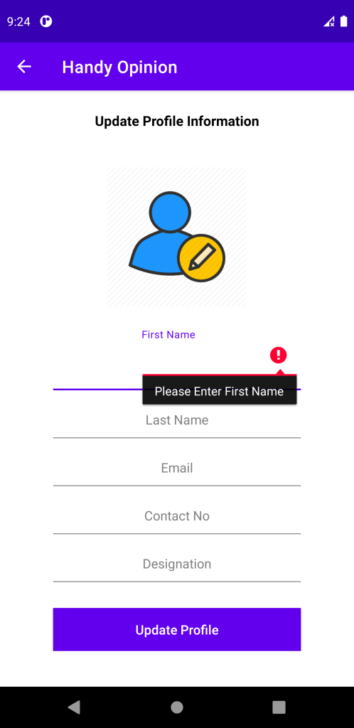
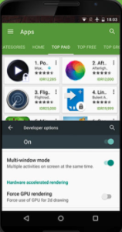
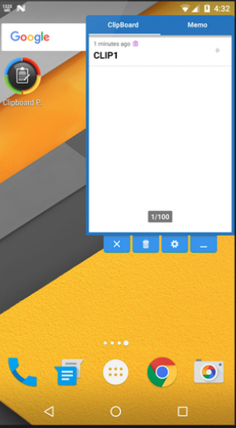
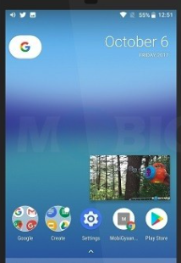
Activities
Definition: An activity is the application’s visual component that interacts with the user
While activities are often presented to the user as full-screen windows, they can also be used as floating windows, Multi-Window mode or embedded into other windows
full screen
Multi window
Floating window
Picture in Picture

Slide 4
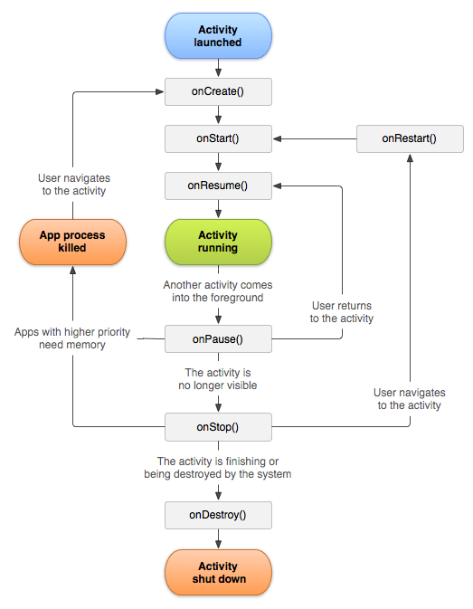
Activity Lifecycle
Activity States:
Foreground: highest position of the topmost stack / active or running
Visible: Lost focus or a non full sized / transparent activity got on top.
Stopped or hidden: Retains all state and member information. No longer visible, will often be killed by the system when memory is needed elsewhere
Destroyed: Finish, or simply killed by the system.

Slide 5
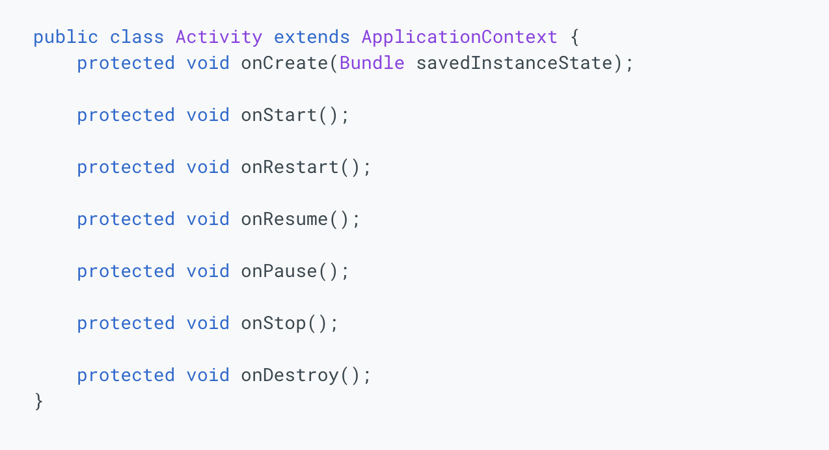
Activity Lifecycle
The entire lifecycle of an activity is defined by the following Activity methods:

Slide 6
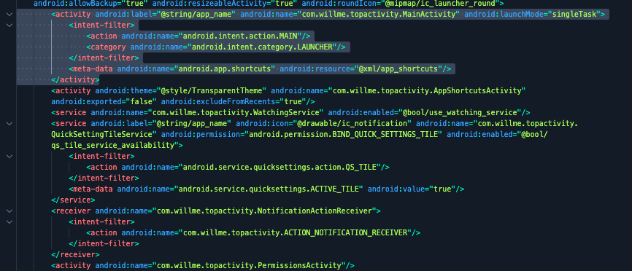
Declaring Activities

Slide 7
Starting An Activity
startActivity(Intent)
startActivityForResult(Intent, int)
onActivityResult(int, int, Intent)
setResult(int)
RESULT_CANCELED, RESULT_OK
Forcing an activity to start through adb / am
$adb shell am start -n <package name>/<activity name>
Note: if the activity is not exported we need root access

Slide 8
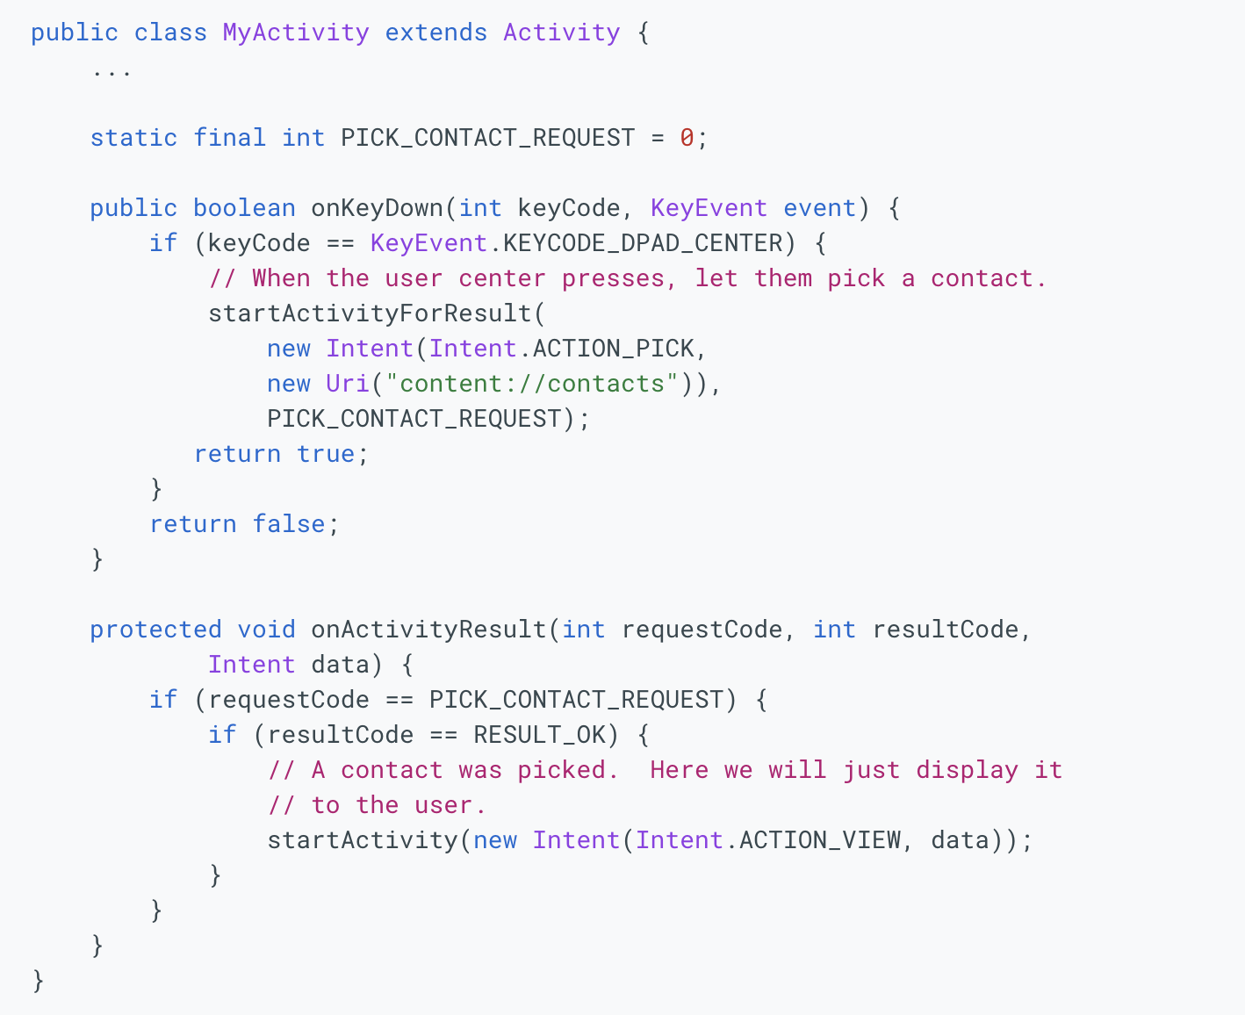
Starting An Activity

Slide 9
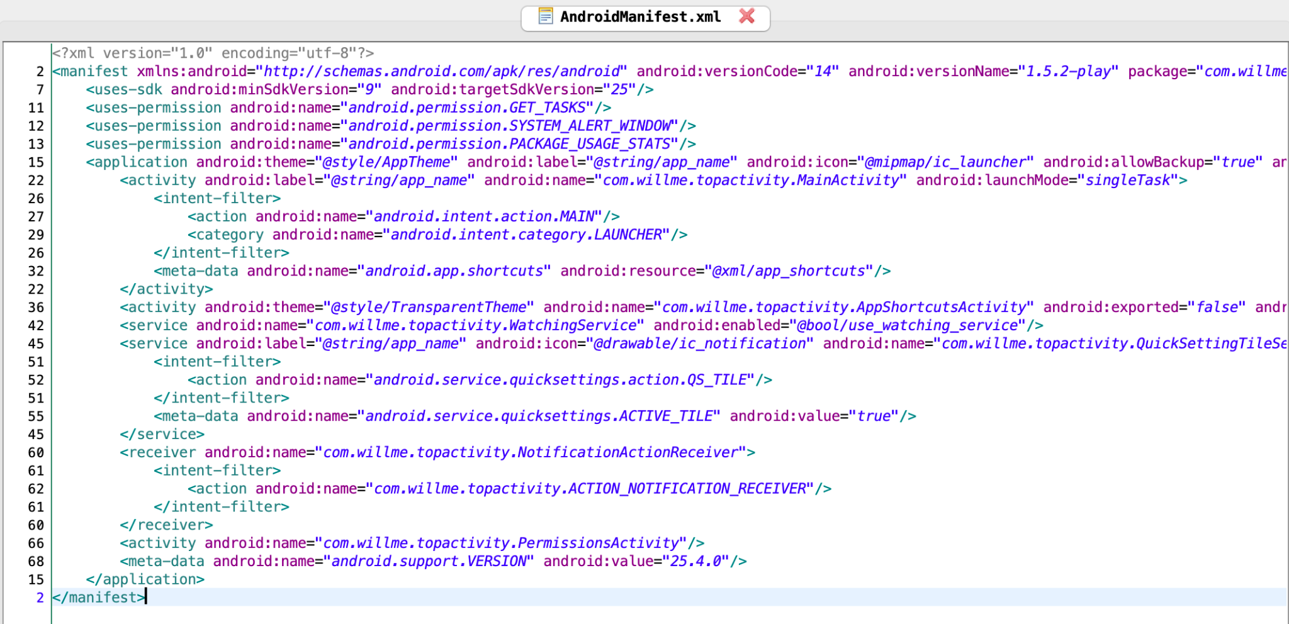
The Main Activity
Main activity: is the first screen to appear when the user launches the app
Search for “android.intent.action.MAIN” and “android.intent.category.LAUNCHER”
The name (MainActivity) might differ

Slide 10
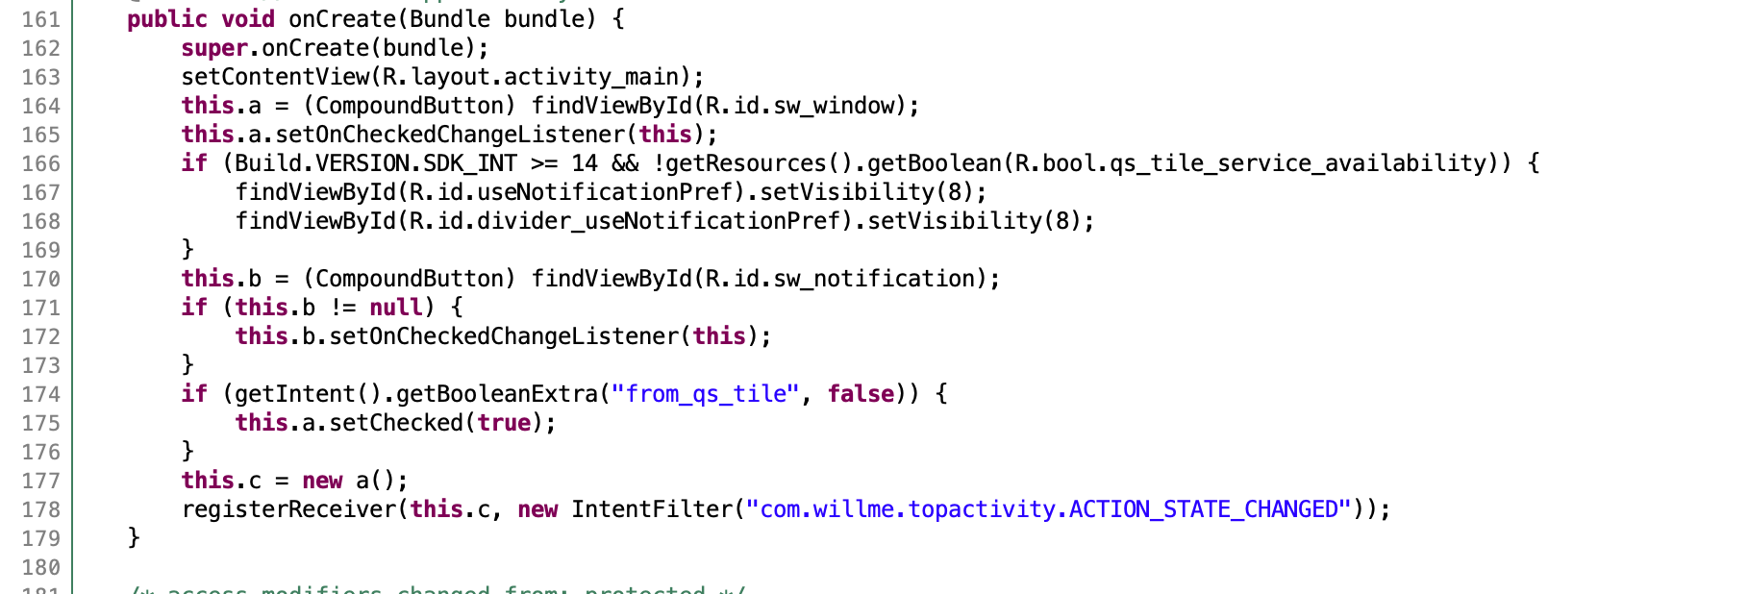
The Main Activity

Slide 11
Application Components
Activities
Services
Broadcast receivers
Content providers

Slide 12

Service
Designed perform long-running operations in the background (download a file, play a media file e.t.c.) , it doesn’t provide a user interface.
May continue running even if the user exit the application (foreground service) or switch to another
A component can interact with a service by binding to it

Slide 13
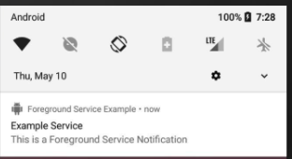
Service Types
Foreground
Noticeable to the user by displaying a notification
Continues running even when the user isn’t interacting with the app
Background
Not directly noticed by the user
Restrictions apply
Bound
Offers a client-server interface that allows components to interact
Since API level 26 or higher, a background service won’t be allowed to run when the Activity is destroyed.
Limits how frequently an app can retrieve the user's current location

Slide 14
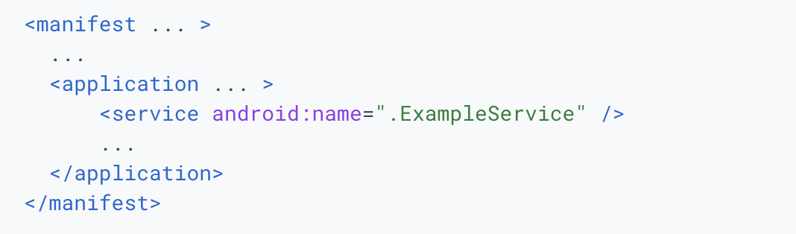
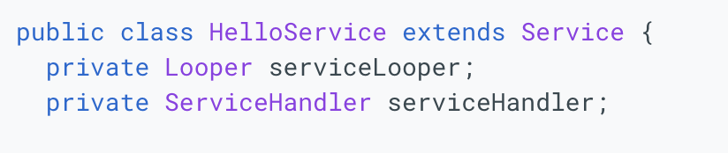
Service Implementation
Declared in the manifest
Extend the Service Class

Slide 15
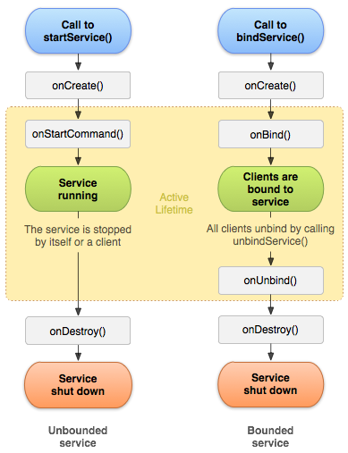
Service main callbacks
startService()
onCreate()
bindService()
onStartCommand()
onBind()
onDestroy()

Slide 16
Application Components
Activities
Services
Broadcast receivers
Content providers

Slide 17
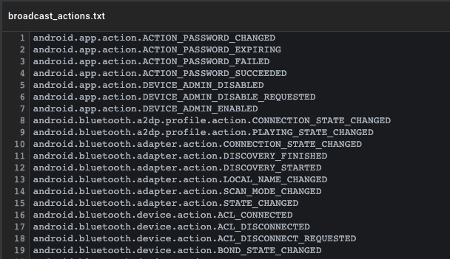
Broadcasts
Broadcast is a message that the system sends when some specific system events occur.
Sent as an Intent to subscribed applications whose action string identifies the event that occurred. The intent may also include additional information bundled into its extra field.
Broadcast Actions List

Slide 18
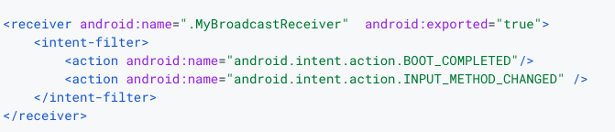
Broadcast Receivers
Apps can receive broadcasts in two ways: through manifest-declared receivers and context-registered receivers.
Manifest Declared Receiver
Context Registered Receiver

Slide 19
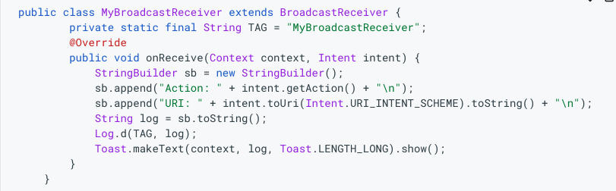
Broadcast Receivers
Extend the BroadcastReceiver class and override the onReceive

Slide 20
Broadcasting
Sending broadcast via an app:
sendOrderedBroadcast(Intent, String) method sends broadcasts to one receiver at a time.
sendBroadcast(Intent) method sends broadcasts to all receivers in an undefined order. This is called a Normal Broadcast.
LocalBroadcastManager.sendBroadcast method sends broadcasts to receivers that are in the same app as the sender.

Slide 21
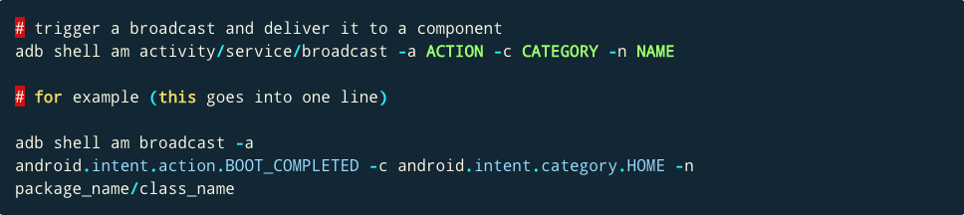
Broadcasting using am

Slide 22
Restrictions
As the Android platform evolves, it periodically changes how system broadcasts behave.
Some important changes:
Android 8.0
Beginning with Android 8.0 (API level 26), the system imposes additional restrictions on manifest-declared receivers:
Not able to use the manifest to declare a receiver for most implicit broadcasts.
Use a context-registered receiver when the user is actively using your app.
Exceptions

Slide 23
Application Components
Activities
Services
Broadcast receivers
Content providers

Slide 24
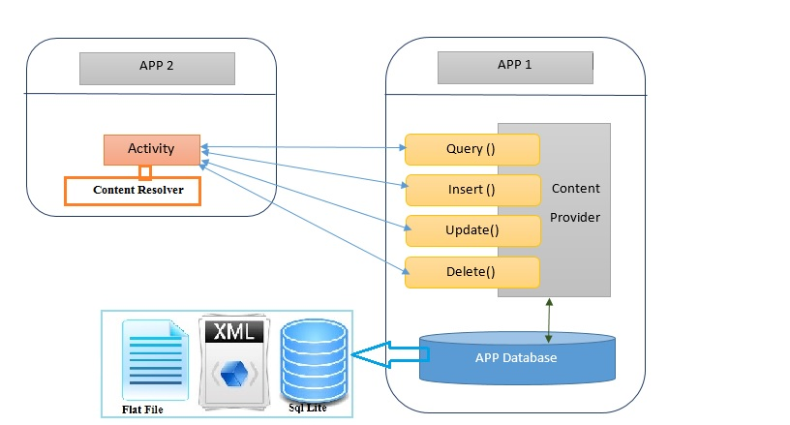
Content Providers
Content Provider components virtualize access to shared data resources, such as local or remote databases.
These components offer methods for data access and modification such as query, insert, delete, and update methods

Slide 25
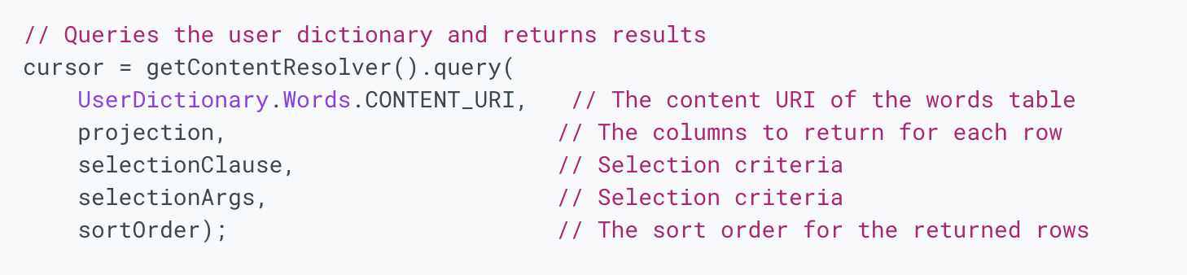
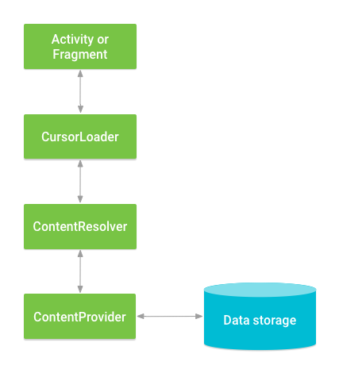
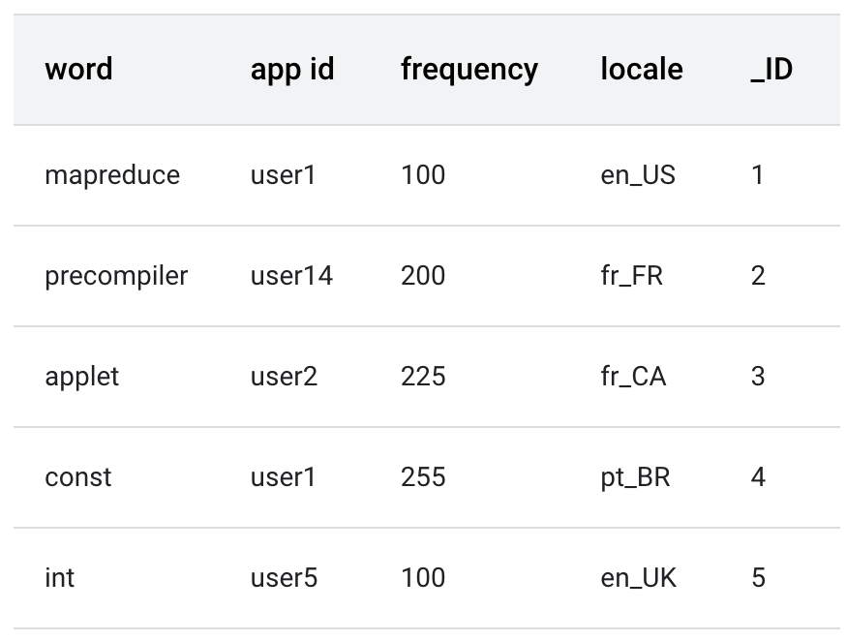
Content Providers
Run an asynchronous query in the background
Communicate with the provider as a client.

Slide 26
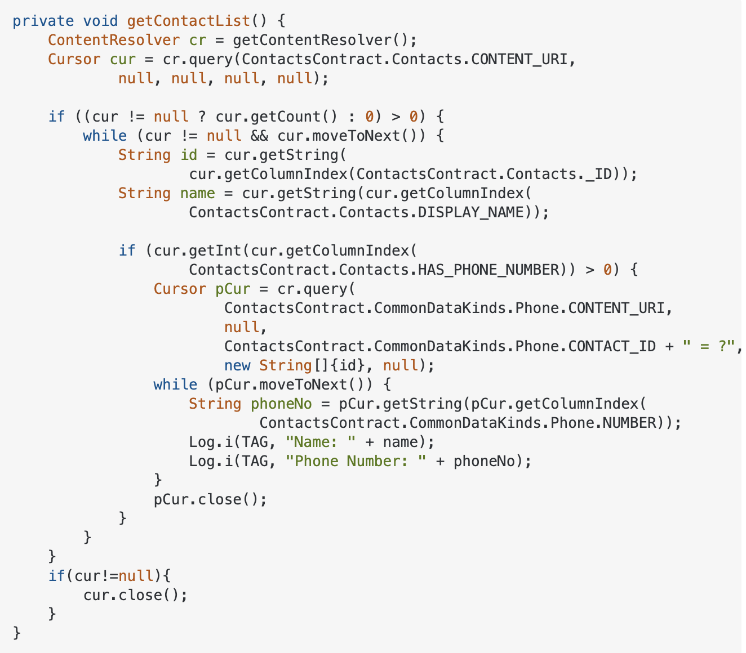
Content Providers Accessing contacts
Create a Content Resolver
Run async query in the background
content://com.android.contacts
Display them in the logcat

Slide 27
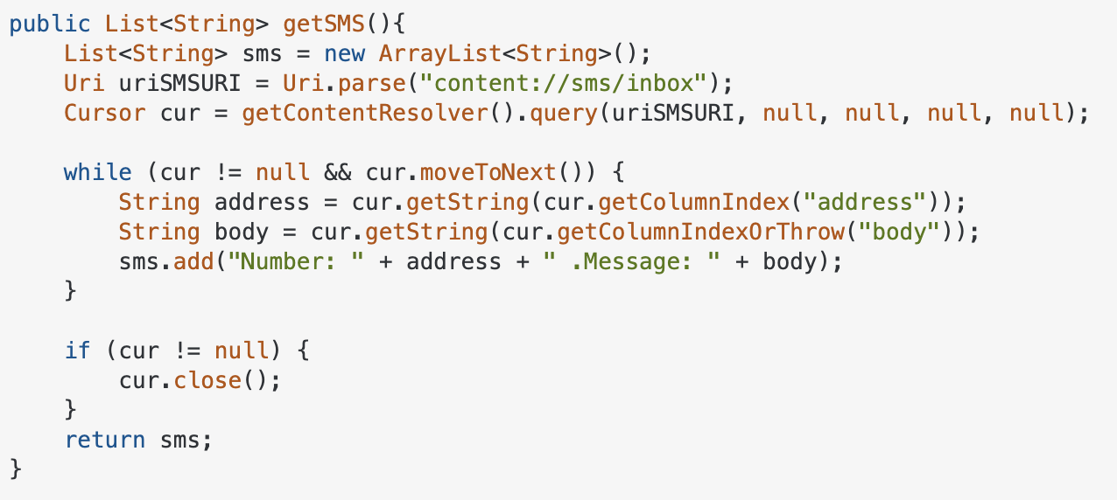
Content Providers - Accessing device SMS
coral:/ $ content query --uri content://sms/inbox
Row: 0 _id=13, thread_id=6, address=PROMOTION, person=NULL, date=1635936120551, date_sent=1635936114000, protocol=0, read=0, status=-1, type=1, reply_path_present=0, subject=NULL, body=

Slide 28
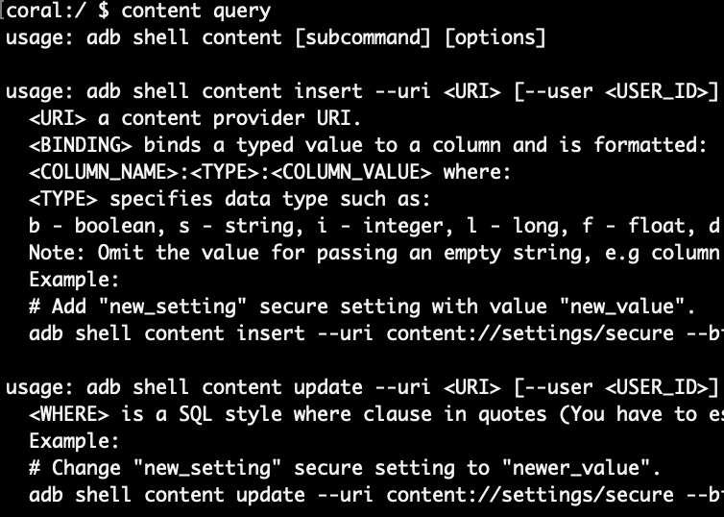
Content Providers - Accessing device SMS- adb shell
coral:/ $ content query --uri content://sms/inbox --projection _id:date --where "_id=1 or _id=2"
Row: 0 _id=2, date=1635606376762
Row: 1 _id=1, date=1635606342476

Slide 29

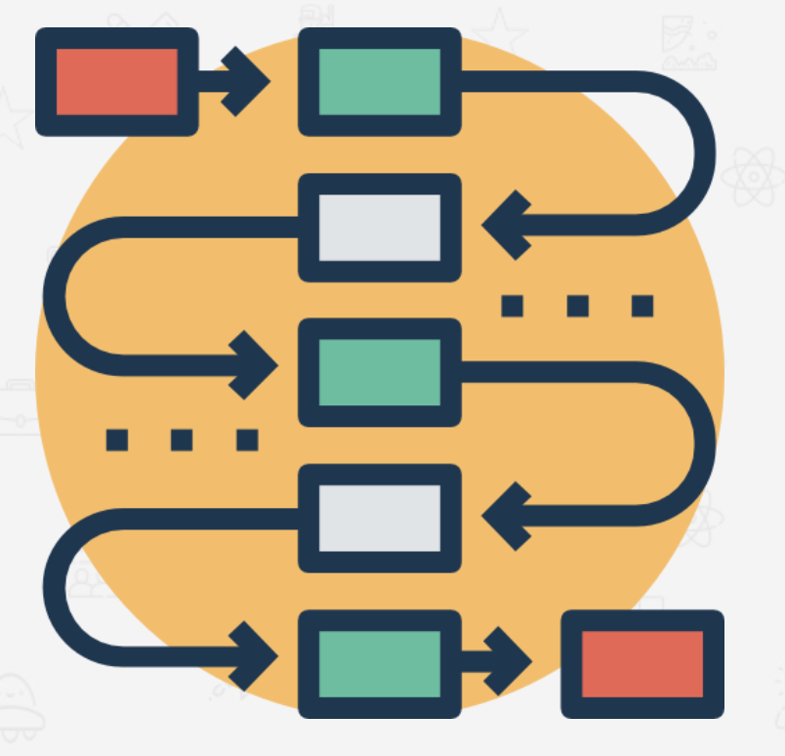

Intents
Intents are objects that facilitate communication between application components
startActivity (Intent intent)
startActivity (Intent intent, Bundle options)
startActivityForResult (Intent intent, int requestCode)
startService (Intent service)
startForegroundService(Intent)
bindService(Intent, ServiceConnection, int)
sendBroadcast(Intent, String)
sendOrderedBroadcast(Intent, String)
sendOrderedBroadcast(Intent, String, BroadcastReceiver, Handler, int, String, Bundle)
Use Cases:
Start an Activity
Start a service
Deliver a broadcast

Slide 30
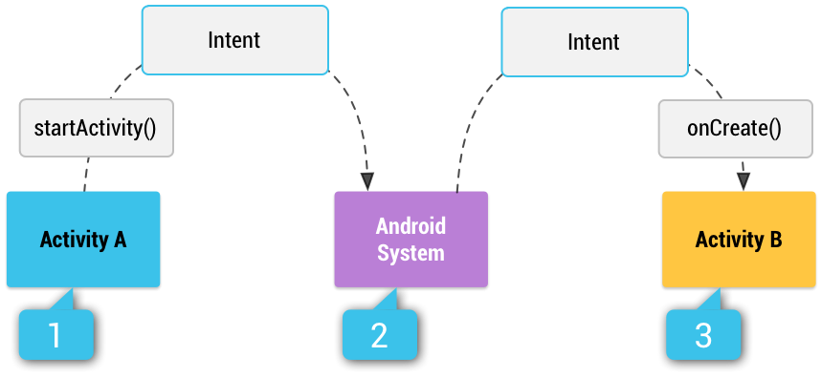
Intent types
Intent intent = new Intent (Intent.ACTION_VIEW); intent.setData (Uri.parse(“https://www.example.com”));
Implicit
INTENT
Explicit
Intent download= new Intent(this, DownloadService.class);

Slide 31
Intent data wrapping
com.foo.bar.component
Component name
intent.setData(Uri.parse(data));
Data
Category
addCategory(String category)
Action
setAction(String Action)
Extras
putExtra(String key, [data])
Flags
setFlag(int flags)

Slide 32
Creating Intents using the am (Examples)
$am start-activity --user 0 -n com.foo.bar/.MainActivity
$am start-activity -a android.intent.action.VIEW -n com.foo.bar/.MainActivity
$am start-activity -c android.intent.category.BROWSABLE -a android.intent.action.VIEW -n com.foo.bar/.MainActivity
$am start-activity -n com.foo.bar/.MainActivity --es “Hello” “World”
$am start-activity -n com.foo.bar/.MainActivity --es “Hello” “World” --ez bool true
$am start-activity -W -a android.intent.action.VIEW -d foo://bar
$am start -a android.intent.action.CALL -d tel:+1234567890
$am
[-n <COMPONENT_NAME>]
[-a <ACTION>]
[-c <CATEGORY>]
--user <USER_ID
-W: wait for launch to complete
[--es <EXTRA_KEY> <EXTRA_STRING_VALUE> ...]
--ez <EXTRA_KEY> <EXTRA_BOOLEAN_VALUE> ...]

Slide 33
Creating Intents using the am (...more Examples)
$am start-service -n com.foo.bar.MyService
$am start-foreground-service -n com.foo.bar.MyService
$am broadcast -a android.provider.Telephony.SMS_RECEIVED --es sms_body "test from adb" -n com.foo.bar/.IntentReceiver

Slide 34
References
https://developer.android.com/guide/components/services
https://www.codeproject.com/Articles/818578/An-Absolute-Beginner-s-Guide-to-Building-and-Acces
https://stackoverflow.com/questions/12562151/android-get-all-contacts
https://stackoverflow.com/questions/18353734/getting-all-sms-from-an-android-phone

